Slide 1


LECTURE
Legal Issues
Game Production
Diploma in IT
Notes:
Hello everyone, today’s lesson will touch on some legal issues when it comes to game development. Clearly, I am not a lawyer, so whatever I teach in this lesson should not be considered legal advice. For any formal legal matters, you should consult an actual lawyer. Nevertheless, I will be going over some common legal considerations you are likely to encounter in the game industry.

Slide 2

Legal Issues
Notes:
Most legal issues are concerned with one thing: money. If you agree to deliver something and you don’t, you must pay money. If you use something of mine without permission, pay money. If you make money and I help you, give me some of that money. Remember that the game industry is ultimately an industry, and the purpose of any industry is for its members to earn an income and make a living. Therefore, there are many legal measures put in to protect all parties.

Slide 3

Legal Issues
Common for the producer to communicate with legal personnel on some issues such as:
Negotiating milestones in publishing agreement
Working with licensees on defining licensing agreements
Always good to have some general knowledge
Notes:
In a game studio, it is often the responsibility of the producer to communicate with lawyers for formal legal advice, for example when negotiating a timeline for the development of a game, or working out licensing agreements with publishers. That being said, it is good to have some general knowledge of these factors even if you are not a producer, so let’s get into it.

Slide 4
Intellectual Property Rights
Creative ideas are a commodity
New characters, new storylines, new game designs, new codes, etc.
All can be considered as intellectual property (IP)
Belonging to the creator
Can be sold, bought, traded, given free or licensed
Important to protect as it is potential income to the creator
Several types of IPs exist
Can belong to an individual, group of individuals or company
Needs to be registered
Usually by a specialised lawyer or patent office
Dependent on country of registration
Notes:
First, let’s talk about intellectual property, or IP. The key concept is to treat creative ideas as a commodity, which is something with value that can be shared or traded. This includes new characters and character designs, storylines, game designs, code, songs, music and a whole host of other creative products.
All of these can be considered types of intellectual property. In many cases, they belong to the creator by default without having to sign any legal document, and as a type of property, they can be sold, bought, traded, given away or licensed under some set of terms and conditions. All of this is important because IP’s have the potential to generate income, and this income goes to the parties with the IP rights.
Several types of IP’s exist, including copyrights, trademarks and patents, and we will discuss some of these today. The IP rights can be owned by an individual, a group, a company or some combination of these.
While many types of IP rights go to the creator by default, the rules are different in different countries, so if you have some IP that you wish to protect, it is best to consult a lawyer. Certainly if the IP rights are going to be transferred from one party to another, this has to be registered in the country that you wish to have these rights, and you will have to employ a specialized lawyer or consult a patent office. It’s all very lawyer-y stuff, and that’s why lawyers make the big bucks.

Slide 5
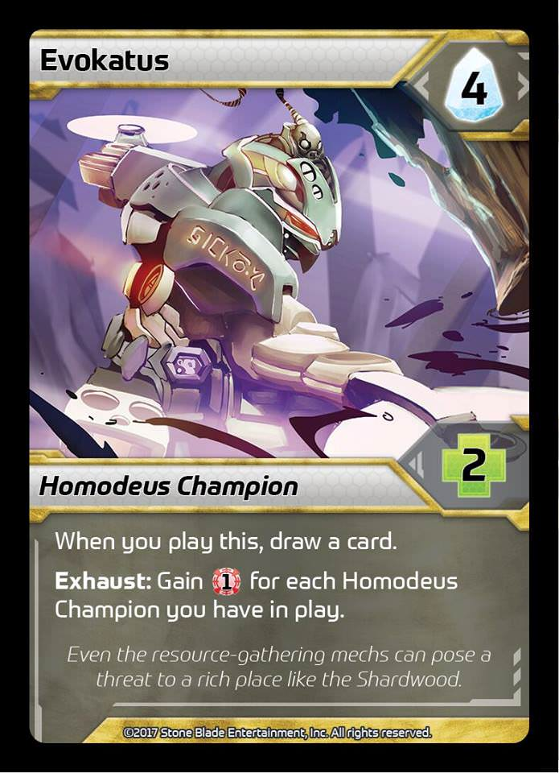
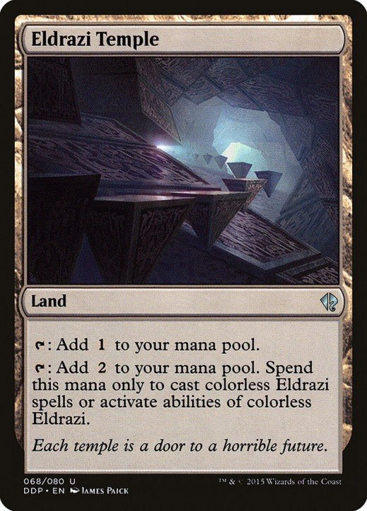

Types of IPs
Copyrights©
Protect original and actual expression of an idea into a tangible medium
Literary works, musical works, sculptures, etc.
Ideas cannot be copyrighted
Notes:
In the games industry, there are several common types of IP. The first is Copyrights, which is denoted in by a small ‘C’ in a circle. Copyrights are legal measures to protect original and actual expressions of an idea into a tangible medium. This includes literary works like books and screenplays, musical works, paintings and sculptures, and of course, video games. Take note of the underlined words – these must be expressions of ideas, and they must be tangible. The ideas themselves are not copyrightable, only their expression. You cannot copyright the idea of a match-3 puzzle game, but King can certainly copyright its concrete implementation called Candy Crush.
There is a very famous case in game design where Wizards of the Coast, the makers of the collectable card game Magic: the Gathering, copyrighted the “tap” mechanic (actually, they also patented it – more on that later). For those of you who haven’t played Magic: the Gathering, the “tap” mechanic is one where you turn a card sideways to show that the card has used its ability. This means that no other game can implement a similar mechanic and call it “tap”, which is why you see so many games with this type of mechanic call it some other term like “exhaust” or “tilt”. Whether Wizards of the Coast actually got any benefit out of copyrighting this idea is debatable, but it certainly garnered attention, and I guess any sort of publicity is good, right?

Slide 6

Types of IPs
Trademarks®™
Identifying symbols, words or devices used to distinguish the trademarked item
Ubisoft®, Big Mac®, shape of a Coca-Cola bottle, etc.
Must be distinguishing and not generalised
Notes:
Next, let’s talk about Trademarks. These are words, symbols or devices that have some distinctive feature which causes the consumer to think of a particular company when they encounter it. This includes the name of the company, like Ubisoft or Blizzard, the name of a product, like Big Mac or iPad, or something else entirely, like the shape of a Coca-Cola bottle or even the phrase “You’re fired!” trademarked by Donald Trump’s use of it in The Apprentice.
The intention of trademark law is to avoid confusion to the consumer. If something is closely associated with a company and another party uses it, it is likely that the consumer will assume that this new product is associated with the original company when it is not. Therefore, something can be trademarked only if it is distinguishing and not generalized.
There are two labels associated with trademarks: a smal ‘TM’ and the circled ‘R’. What’s the difference? Well, putting TM does not require registering, and you can do this to signal your intention that you will eventually be registering this as your trademark. The circled ‘R’ indicates that it is in fact a registered trademark with all the rights granted by this.

Slide 7






Types of IPs
Trade Secrets
Information that a company keeps secret and gives them a competitive edge
Costs money to develop and generates revenue
Google search engine, recipe of KFC, etc.
Notes:
The third type of IP we will discuss is Trade Secrets. This is information that gives a company a competitive advantage over its competitors, usually costing money to develop and has the potential to generate revenue. Classic examples include Google’s search engine algorithm, KFC’s recipe with 11 herbs and spices, and the formula for Listerine.
Registering something as a trade secret protects against someone revealing it to unauthorized people, such as a former employee revealing it to his new company. However, it does not protect against someone arriving at the same thing independently or through reverse engineering. So if you want to experiment and come up with your own version of KFC chicken, go ahead. Hmm, I’m getting hungry for some reason.

Slide 8
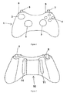

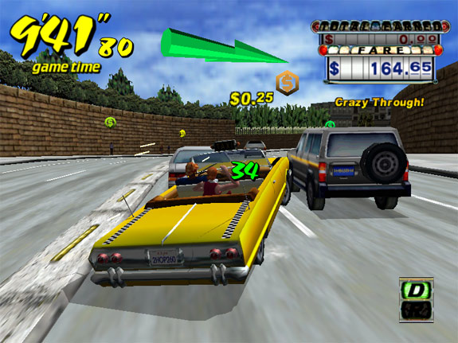
Types of IPs
Patents
Applies to inventions
Does not apply to ideas
Must be new, involve some inventive step and have a useful application
Prevent others from making, using or selling for a fixed time frame
Becomes public domain after expiry
Notes:
The last type of IP we will talk about is patents. Like all other types of IP, patents apply to inventions that are concrete implementations of ideas, not to the ideas themselves. To qualify for a patent, the invention must be new, it must involve some non-trivial inventive step, and it must have a useful identified application.
Once a patent has been successfully filed, it prevents others from making, using or selling the item for a fixed length of time depending on the country where the patent was filed; for both the United States and Singapore, this period is 20 years. Once this period is over, the item becomes public domain and can be freely exploited by everyone.
Many common everyday objects were once patented and greatly benefited its inventor, like the light bulb and the zipper. Examples in the video game industry include various controller designs, AR and VR technologies, and even Sega’s patent of having an arrow indicate the direction that the player should travel in a driving game, which was the subject of a lawsuit against Fox Interactive in 2003.

Slide 9

Legal Agreements
Contracts between 2 or more parties that outline responsibilities and duties
Work for hire
Who owns what
Non-disclosure agreements (NDA)
Allow sharing of ideas
Development contracts
Normally between publisher and game studio
End User License Agreements (EULA)
Establishes ownership, prevents resale and piracy
Terms of Service (TOS)
Outlines behavior of players in the game world
Notes:
Beyond intellectual property issues, there are other common legal agreements in the games industry. Legal agreements are contracts between two or more parties that state clearly the duties and responsibilities of the parties involved.
For example, a work for hire contract is signed when a game studio or publisher hires another party to provide a service, whether it is to get a freelance artist for some concept art or a freelance programmer to code a section of the game. In this contract, things like the nature of the work, deadline for delivery and who owns the asset created are specified.
Non-disclosure agreements, or NDA’s, are important especially during development and before deployment. This allows the sharing of ideas among the parties with the legal protection that the shared ideas are not revealed to others.
Development contracts are usually signed between game publishers and game studios, and are generally longer term than work for hire contracts. Development contracts represent an understanding that the publisher will finance the studio’s game or games, and the publisher will therefore get a share of the profits.
Finally, there are two common legal agreements between game companies and the players. The first is the End User License Agreement, or EULA, which basically says that even though you bought the software, you are not allowed to freely distribute it or, worse yet, sell it. The other is the Terms of Service, which you will have to agree to when you play an online game. The TOS tells players that they have to adhere to certain rules, such as not selling game objects or not having multiple accounts, and that the game company can remove the player from the game if they violate these terms. This is the reason why Disguised Toast was banned from Hearthstone so many times.

Slide 10
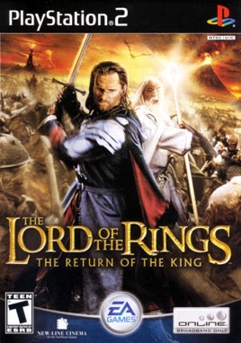

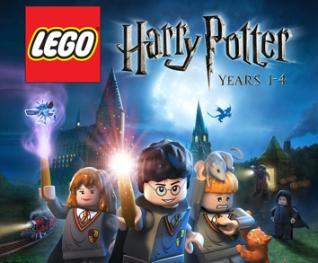
Licenses
Games based on licenses are increasingly common
LOTR, UFC, Harry Potter
Ready audience for play
Licensor may or may not be actively involved
Retains approval rights
Have to retain look and feel of the license
Producer has to actively check on this
Have to maintain proactive relationship with the licensor
Notes:
The last thing we will talk about is licenses, which is extremely important in the video game industry. There are many games that are based on existing IP’s possibly from other forms of media, such as Lord of the Rings, UFC and Harry Potter. These existing IP’s have an existing fanbase, which increases the potential size of the target audience.
When a company wishes to make a game based on an existing IP, the licensor of that IP may or may not be actively involved. Sometimes the licensor may have strong opinions on the nature of the game and be involved from conceptualization to deployment, other times they are happy to let the game studio make the game with little interference. In any case, the licensor usually retains approval rights.
One of the most important things to ensure when making a licensed game is that it retains the look and feel of the license. Disney properties should be family friendly, Spiderman should not suddenly have the ability to fly, and the game probably shouldn’t kill off main characters without the consent of the licensor. Usually it is the producer (with the aid of the designer and the rest of the team) who has to make sure that the game does not tarnish the license, which means that he should be very familiar with the source material. The best licensed games are ones where the development team and the licensor have a strong proactive relationship, and all parties are trying to create a game that adds to the strength of the licence.

Slide 11
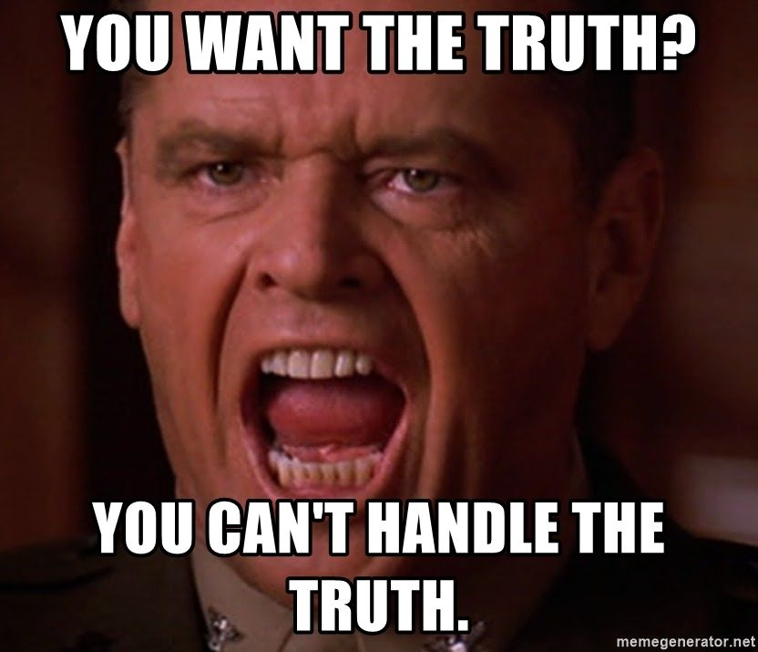
Summary
You should have a better understanding of:
Copyrights
Trademarks
Trade secrets
Patents
Legal agreements
Licenses
Notes:
OK, so that was our brief visit into the world of law and video games. You should have a better understanding of copyrights, trademarks, trade secrets and patents: what they are used for, what they protect and what they do not protect. We talked briefly about different legal agreements like work for hire, NDA’s, development contracts, EULAs and Terms of service, and also discussed some issues to consider when developing licensed games based on existing IP’s. But I want to repeat: I am not a lawyer, and for any legal issues there is no getting around consulting an actual lawyer to get to the truth of the matter.
You want the truth? You can’t handle the truth! Yeah, sorry, this has nothing to do with our lesson, I just wanted to say the line. ☺

